Slide 1

CSE488: Big Data Analytics
Lecture 4:
Data Flow Details &
Algorithms using MapReduce
Dr. Mohammad Rezwanul Huq
Associate Professor
East West University

Slide 2

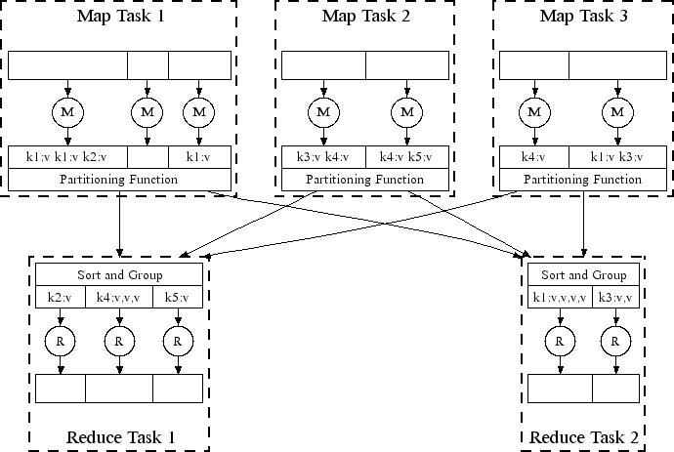
All phases are distributed with many tasks doing the work

Slide 3
MapReduce environment takes care of:
Partitioning the input data
Scheduling the program’s execution across a set of machines
Performing the group by key step
  In practice this is is the bottleneck
Handling machine failures
Managing required inter-machine
communication

Slide 4
Data Flow Basics
Input and Final Output are stored on the DFS.
  Scheduler tries to schedule map tasks “close” to physical storage location of input data.
  Brings computation close to the data
Intermediate results are stored on local file system of Map and Reduce worker nodes, if possible to reduce network traffic.
Final output could be an input of another MapReduce tasks.

Slide 5
Coordination: Master Node
Master node takes care of coordination.
  Task status: idle, in-progress, completed
  Idle tasks get scheduled as worker becomes available
  When a map task completes, it sends the master the location and sizes of its R intermediate files, one for each reducer
  Master node pushes this info to reducers
Master pings workers periodically to detect failures.

Slide 6

Map worker failure
  Map tasks completed or in-progress at worker are reset to idle and rescheduled
  Reduce workers are notified when map task is rescheduled on another worker
Reduce worker failure
  Only in-progress tasks are reset to idle and the reduce task is restarted
  Idle reduce tasks rescheduled on other workers
Master Failure
  MapReduce task is aborted and client is notified

Slide 7
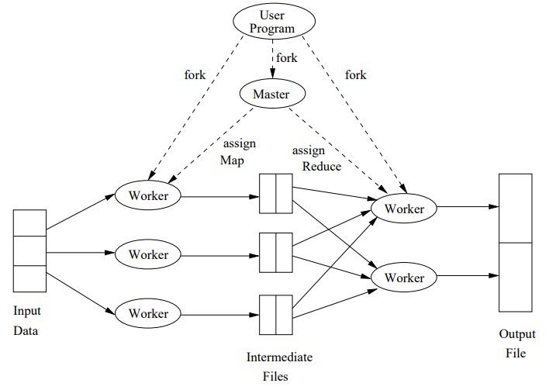
Execution of a MapReduce Program

Slide 8
How many Map and Reduce jobs?
M map tasks, R reduce tasks
Rule of thumb
  M > number of computing nodes
  One DFS chunk per map task is common
  Improves dynamic load balancing and speeds up recovery from worker failures
Usually R is smaller than M
  Because output is spread across R files
  Large number of files with partial output is troublesome.

Slide 9
Reduce Tasks, Reducer and Skew
Smaller number of reduce tasks, R < M
Each reduce tasks may contain multiple keys
Different reducers may take different amount of time for a reduce tasks
Consider the following situation – one reduce task for each reducer
Resulting into Skew - a signiﬁcant diﬀerence in the amount of time each takes

Slide 10
Solution of Skew
Smaller number of reduce tasks than the number of reducers
  If one reducer fails, immediately reschedule the reduce task in another node
Larger number of reduce tasks than the number of reducers
  While one reducer can execute a long reduce tasks, other reducers can execute multiple short reduce tasks.

Slide 11
Solution of Skew
Smaller number of reduce tasks than the number of reducers
  If one reducer fails, immediately reschedule the reduce task in another node
Larger number of reduce tasks than the number of reducers
  While one reducer can execute a long reduce tasks, other reducers can execute multiple short reduce tasks.

Slide 12
Algorithms using MapReduce
MapReduce is not a solution to every problem
DFS makes sense only when ﬁles are very large and are rarely updated in place.
Unlike a large online retailers.
Google implementation of MapReduce was originally created to execute very large matrix-vector multiplications as are needed in the calculation of PageRank (search engine page ranking algorithm)

Slide 13
Matrix-Vector Multiplication (1)
Given, a (n*n) matrix M and
a vector, V of length n.
Find the result vector X.

Slide 14
Matrix-Vector Multiplication (2)
Assuming V can fit in the main memory of computing nodes
Map Function
  Input 🡪 k, v where v = <i, j, m_{ij}>
  Output 🡪 i, m_{ij}*v_{j} for each m_{ij}
Group by key
  all terms of the sum that make up the component x_{i} of the matrix-vector product will get the same key, i.
Reduce Function
  sums all the values associated with a given key i. The result will be a pair (i, x_{i})

Slide 15
Matrix-Vector Multiplication (3)
When V cannot fit in the main memory
We can divide the matrix into vertical stripes of equal width and divide the vector into an equal number of horizontal stripes, of the same height.
The i^{th} stripe of the matrix multiplies only components from the i^{th} stripe of the vector.

Slide 16
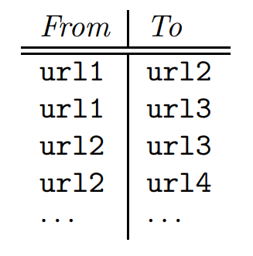
Relational Algebra Operations in MapReduce
There are many operations on data that can be described easily in terms of the common database-query primitives, even if the queries themselves are not executed within a database management system.
Find the URLs referenced by ‘url1’.
Find the URLS referenced by ‘url1’ or
‘url2’.

Slide 17
Selection and Projection in MapReduce
Selection Operation
  Map Function:
    If tuple t satisfies condition then emit (t,t) otherwise none
  Reduce Function:
    Identity function
    Emit (t,t)
Projection Operation
  Section 2.3.5 from the textbook (MMDS)

Slide 18
Computing Set Operations in MapReduce
Set Union
  Map Function:
  Reduce Function:
Set Intersection
  Map Function:
  Reduce Function:
Set Difference
  Comparatively complicated
  Map Function: For a tuple t in R, produce key-value pair (t, R), and for a tuple t in S, produce a key-value pair (t, S).
  Reduce Function: For each key t, if the associated value list is [R], then produce (t, t). Otherwise, produce nothing.

Slide 19
Natural Join in MapReduce (1)
Compute the natural join R(A,B) ⋈ S(B,C)
R and S are each stored in files
Tuples are pairs (a,b) or (b,c)
A | B
a₁ | b₁
a₂ | b₁
a₃ | b₂
a₄ | b₃
B | C
b₂ | c₁
b₂ | c₂
b₃ | c₃
A | C
a₃ | c₁
a₃ | c₂
a₄ | c₃
⋈
=
S
R

Slide 20
Natural Join in MapReduce (2)
Use a hash function h from B-values to 1...k
A Map function turns:
  Each input tuple R(a,b) into key-value pair (b,(a,R))
  Each input tuple S(b,c) into (b,(c,S))
Map task send each key-value pair with key b to Reduce process h(b)
  Partitioner automatically do this. Only, set number of reduce tasks same as k.
Each Reduce task matches all the pairs
(b,(a,R)) with all (b,(c,S)) and outputs (a,b,c).

Slide 21
MapReduce is great for:
  Problems that require sequential data access
  Large batch jobs (not interactive, real-time)
MapReduce is inefficient for problems where random (or irregular) access to data required:
  Graphs
  Interdependent data
    Machine learning
    Comparisons of many pairs of items

Slide 22
In MapReduce we quantify the cost of an algorithm using
Communication cost = total I/O of all processes
Elapsed communication cost = max of I/O
along any path
(Elapsed) computation cost analogous, but count only running time of processes
Note that here the big-O notation is not the most useful (adding more machines is always an option)

Slide 23
For a map-reduce algorithm:
  Communication cost = input file size + 2 × (sum of the sizes of all files passed from Map processes to Reduce processes) + the sum of the output sizes of the Reduce processes.
  Elapsed communication cost is the sum of the largest input + output for any map process, plus the same for any reduce process

Slide 24
Either the I/O (communication) or processing (computation) cost dominates
  Ignore one or the other
Total cost tells what you pay in rent from your friendly neighborhood cloud
Elapsed cost is wall-clock time using parallelism

Slide 25
= O(|R|+|S|+|R ⋈ S|)
Total communication cost
Elapsed communication cost = O(s)
  We’re going to pick k and the number of Map processes so that the I/O limit s is respected
  We put a limit s on the amount of input or output that any one process can have. s could be:
    What fits in main memory
    What fits on local disk
With proper indexes, computation cost is linear in the input + output size
  So, computation cost is like communication cost

